Slide 1

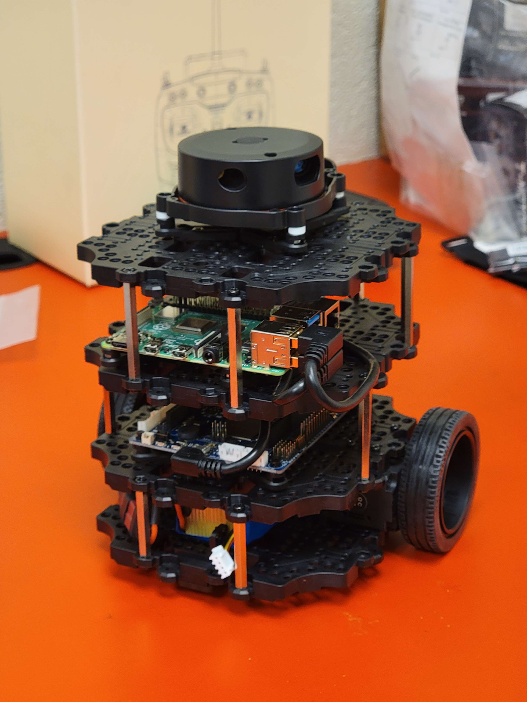
NibblesBot
Ethen Carrell
Charles Moertle
Calab Reeder

Slide 2
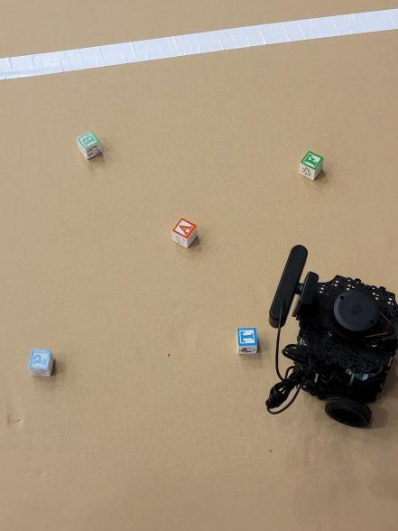
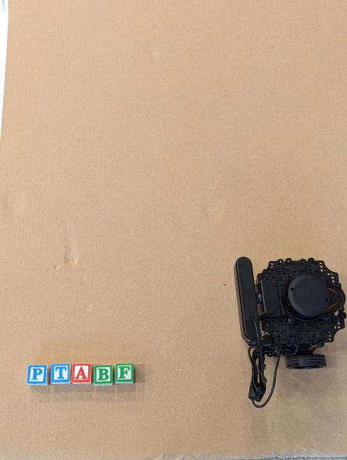
Task

Slide 3
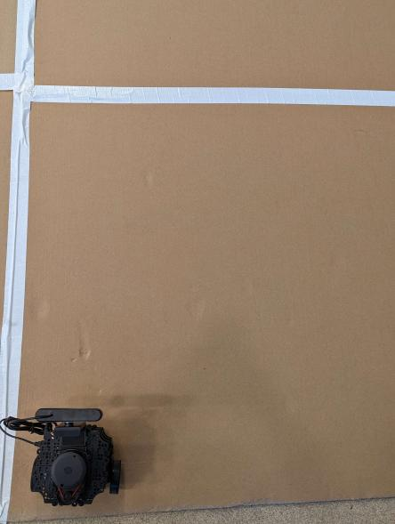
Designing the Environment
Hard Surface
Clear Environment
Color Control
Tape will be used for walls

Slide 4
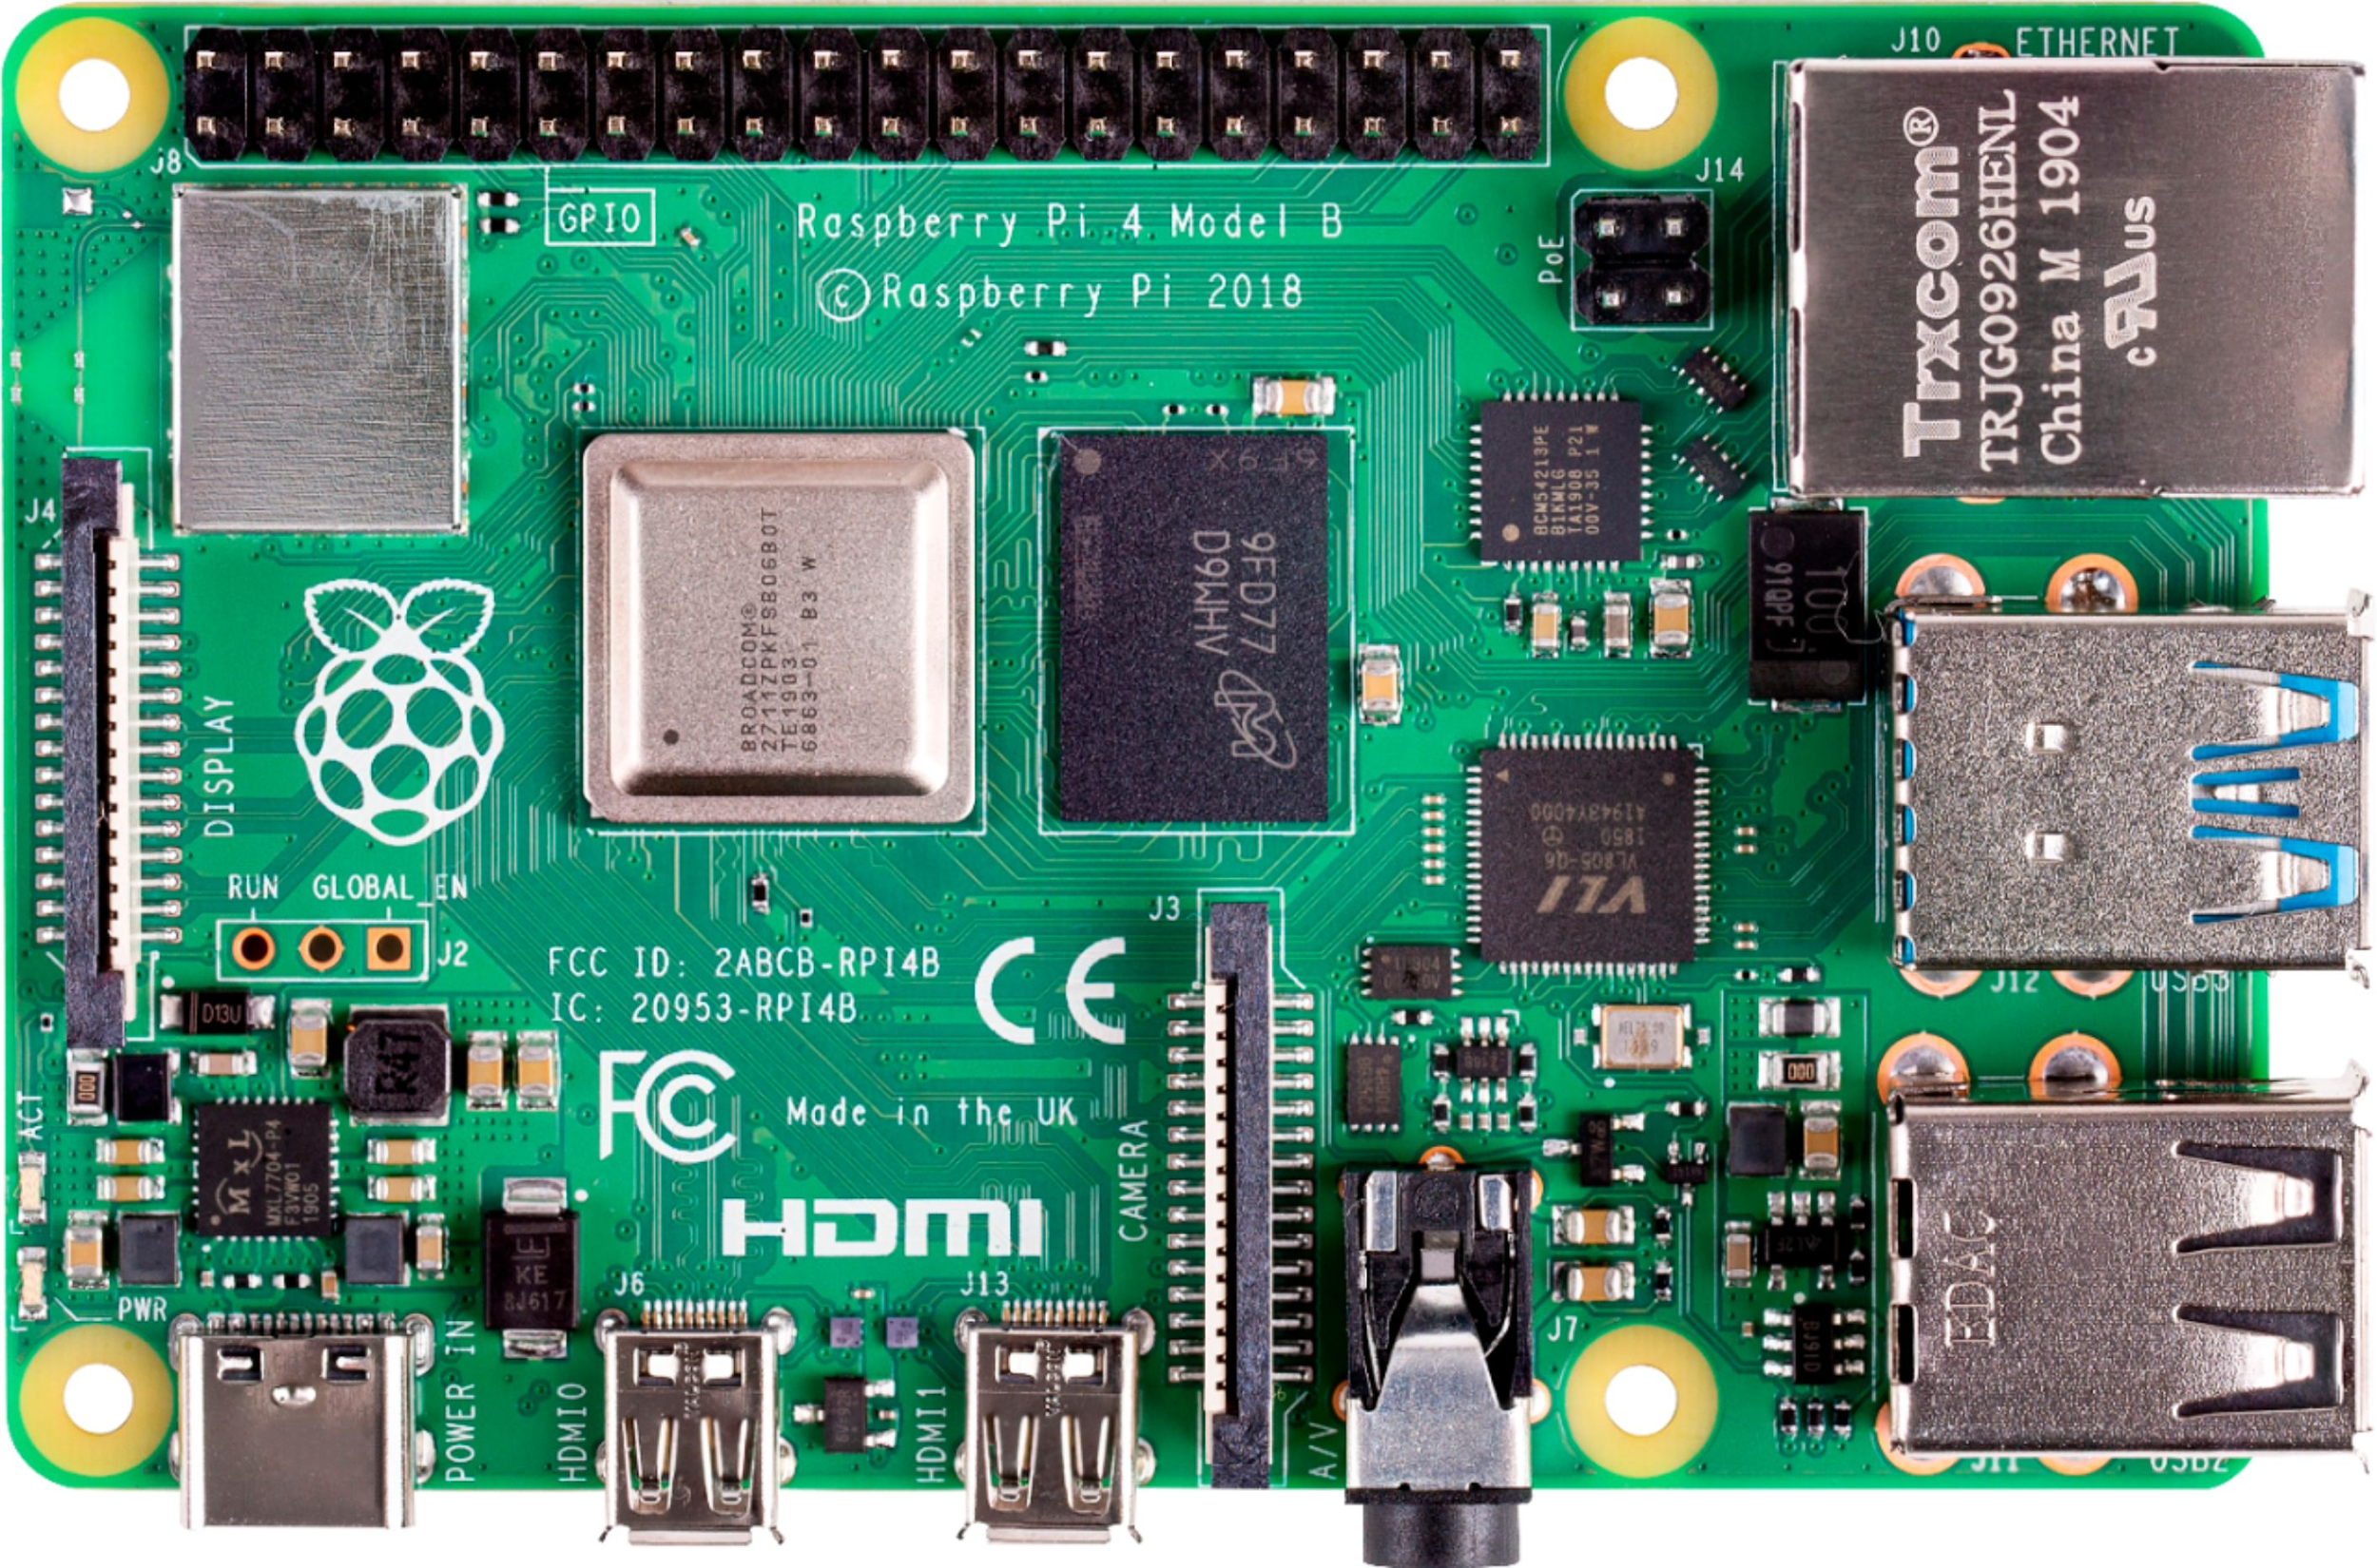
Robot Design
Drive systems
Camera
Pi 4 B

Slide 5
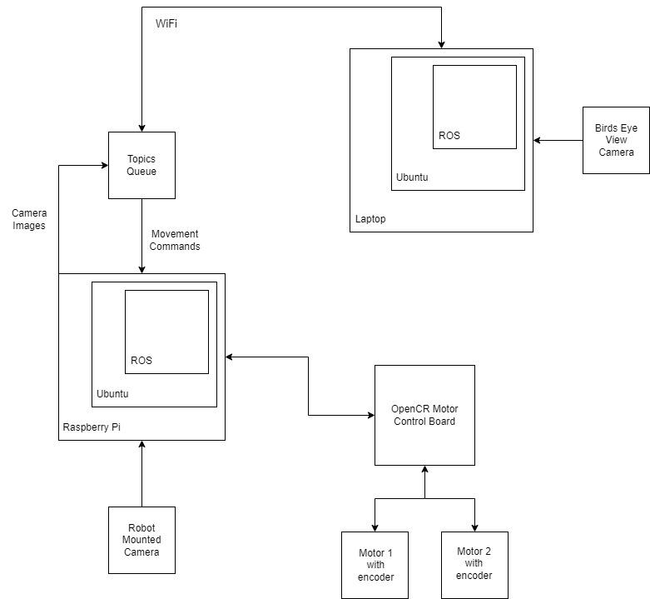
ROS
ROS Noetic
Networked ROS
Rostopics

Slide 6
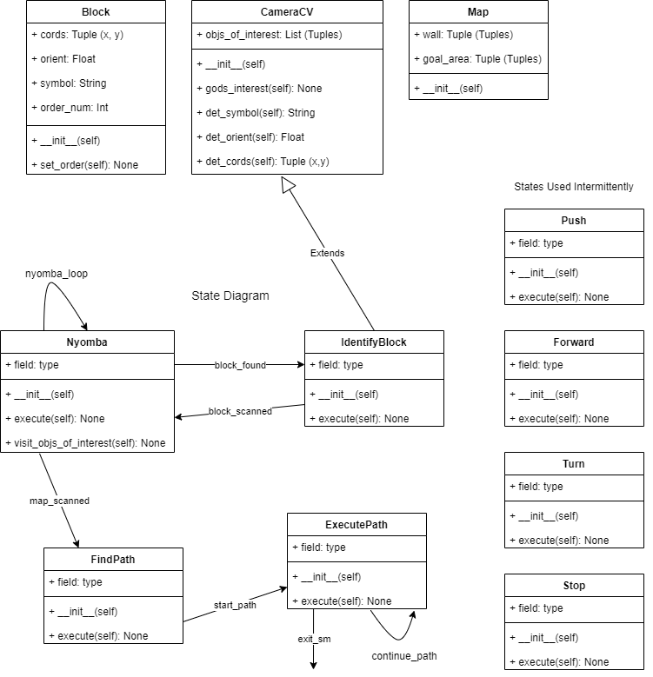
State Machine
Locomotion
Navigation
Logic

Slide 7
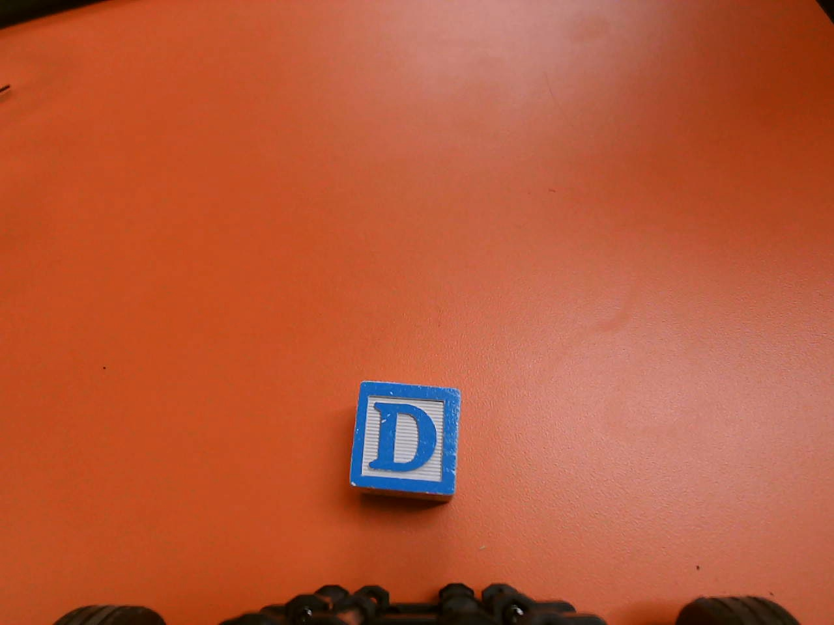
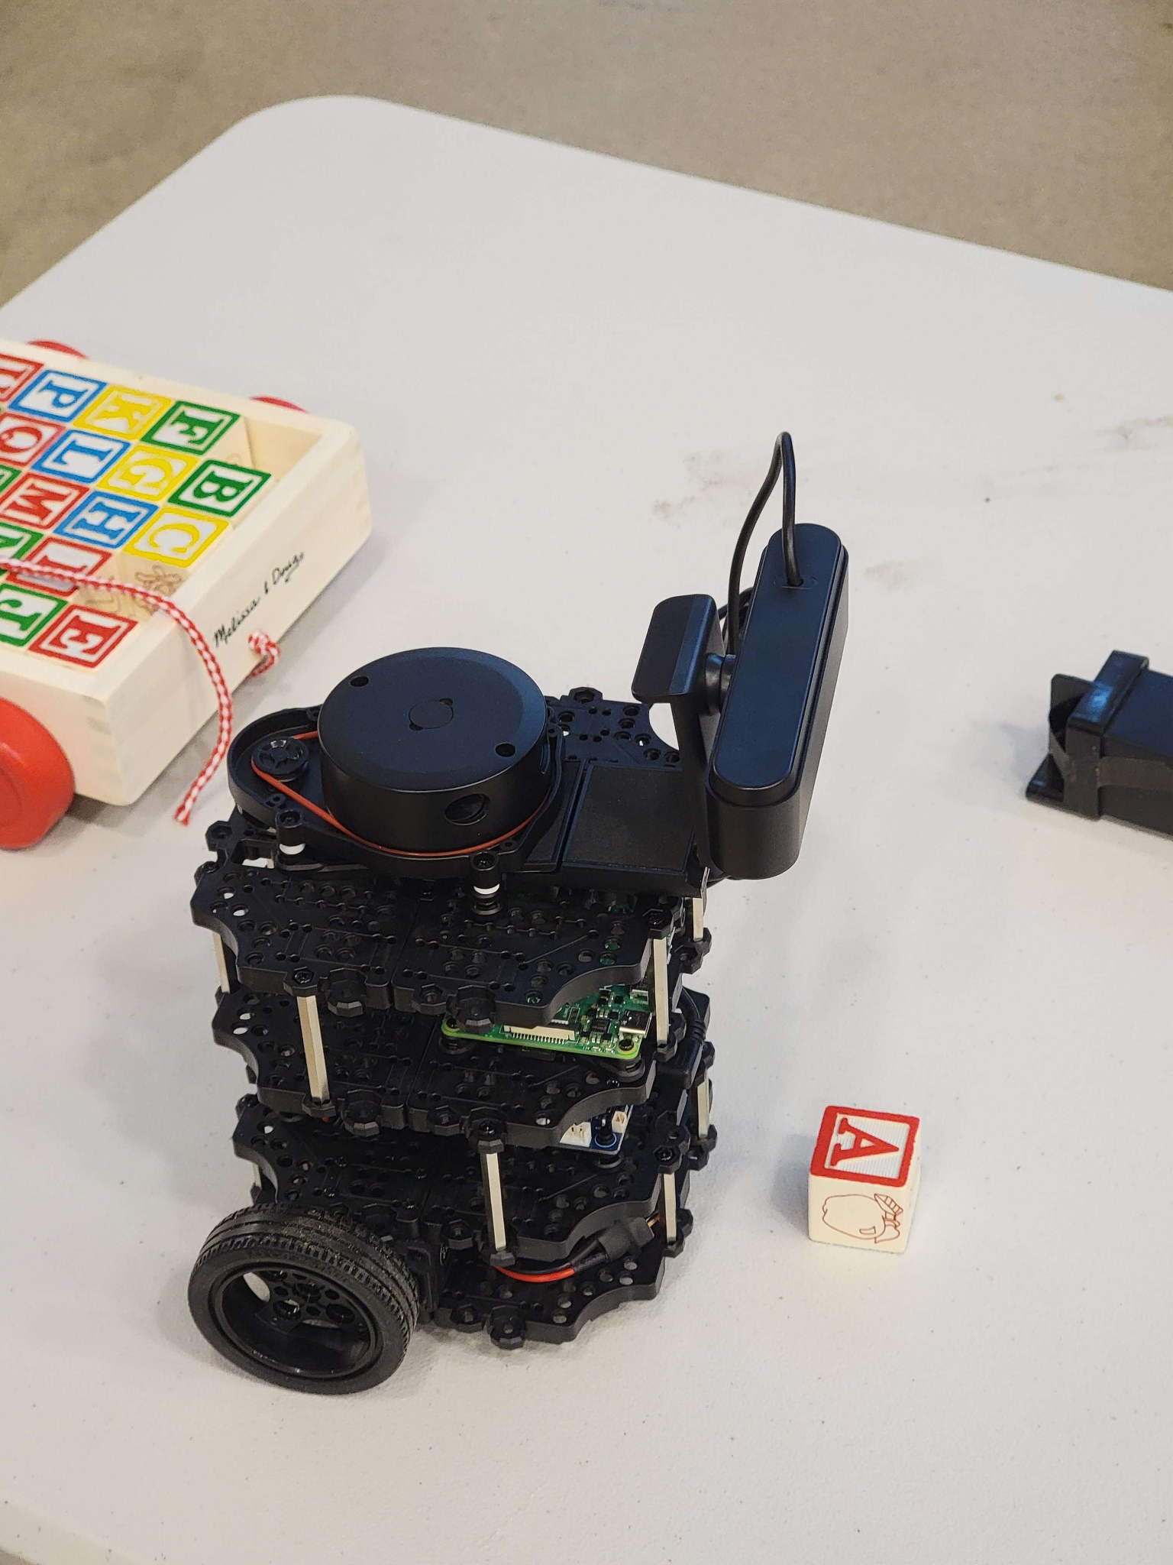
Computer Vision
What NibblesBot sees
Camera mounted on NibblesBot

Slide 8
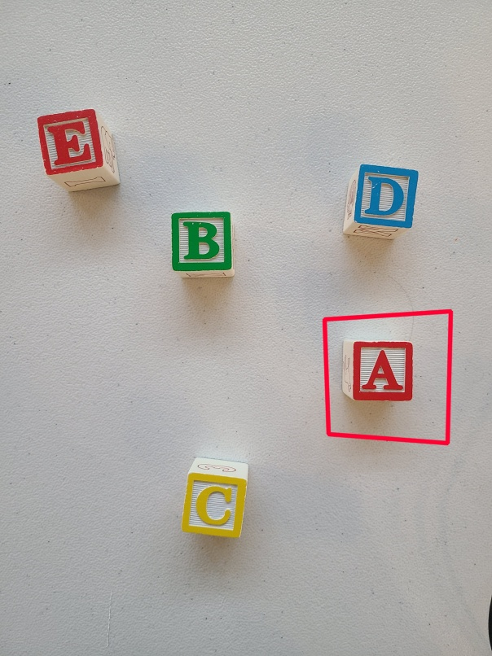
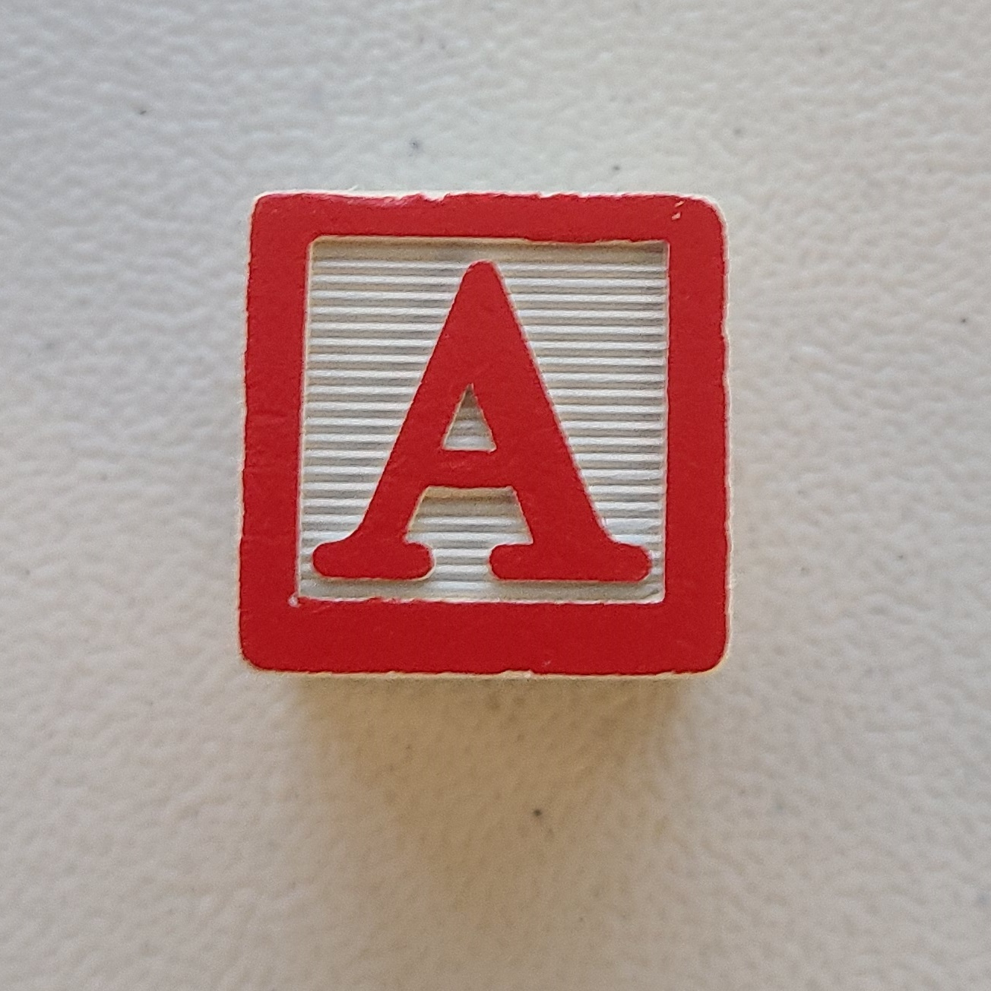
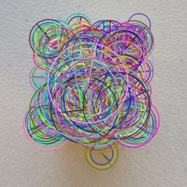
Computer Vision
Testing Image
Using ORB feature detection
Detect key points and compute descriptors from images
Initialize a Brute Force Matcher
Draw bounding box in testing image
Training Image
<- 1000 Features

Slide 9
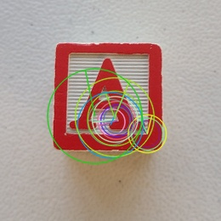
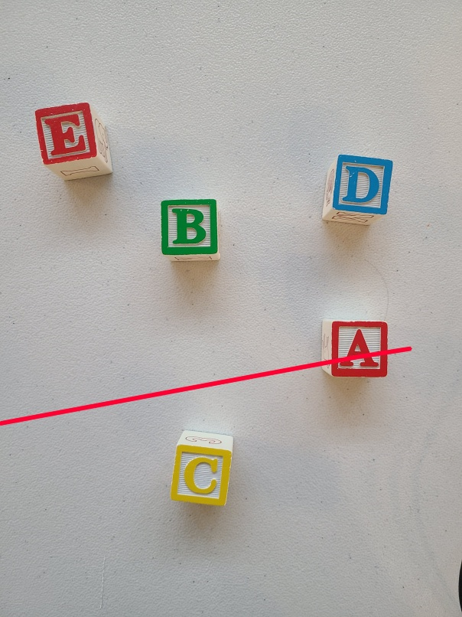
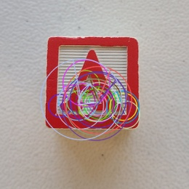
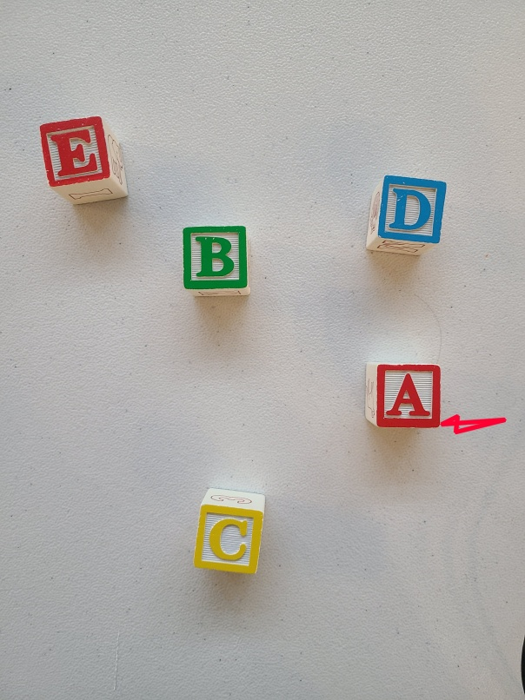
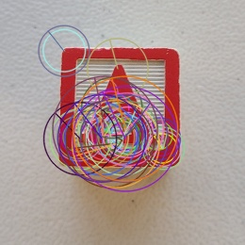

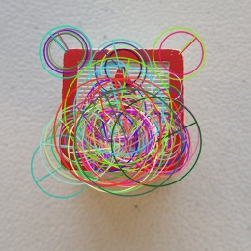

13 Features
25 Features
50 Features
100 Features

Slide 10
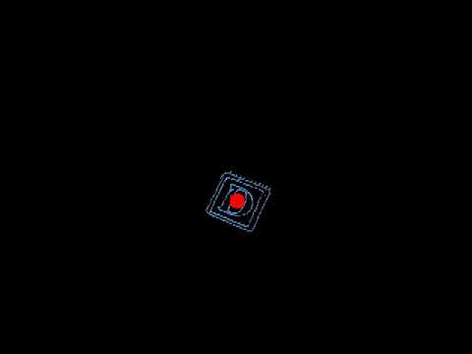
Computer Vision
Using centroid detection
Mask the image
Calculate moments
Derive the centroid

Slide 11
Computer Vision
Future planned software:
Combine ORB and Centroid
Dynamic cropping of image
Drive towards and push with centroid
2. CV to detect block orientation
Orientation relative to black tape wall
Used especially for block rotation

Slide 12
Experimental Design
Experiment 1: Find Block
Experiment 2: Boundary Check
Experiment 3: Approaching a Block
Experiment 4: Pushing a Block
Experiment 5: Block Navigation
Experiment 6: Solve Puzzle

Slide 13
Experiment 1: Find Block
Find block
Find a block on the map
Blocks will be in the same spot and orientation each test
Robot will always start in the same corner
Approach block and stop before bumping into it
Does not have to be directly facing the block
Read the symbol from the block
Attempt to read the symbol from multiple orientations
Find orientation of the block in relation to boundary
Degrees will be documented in a similar format as Odometry: -180, -90, 0, 90, 180

Slide 14
Experiment 2: Boundary Check
Check if wall boundary is working
Robot cannot cross black tape
Robot must turn if driving towards the corner of the boundary

Slide 15
Experiment 3: Approaching the Block
Approach block parallel from front (bottom of letter)
First approach the block parallel to one of the faces
Next attempt to approach block using identified front face
Will require moving around block until on front faced side
Must not accidently move the block in the process

Slide 16
Experiment 4: Pushing the block
Push block
Push blocks in a straight line
Try rotating blocks
Push blocks while turning
Robot must avoid pushing blocks across the boundary

Slide 17
Experiment 5: Block Navigation
Navigate around blocks
Keep awareness of multiple blocks by not bumping into any of them
Must be able to understand which movements are acceptable in all situations
Acceptable in the sense a movement will not unintentionally move a block

Slide 18
Experimental 6: Solve Puzzle
Push multiple blocks in the same test and arrange the blocks
Keep awareness of block locations when pushing blocks to designated area
Robot should not bump into any other block while pushing
Robot should know which blocks have and have not been moved to designated area
Robot should place the blocks in designated order

Slide 19
Sources
Bapat, Krutika. “Find Center of a Blob (Centroid) Using Opencv (c++/Python).” LearnOpenCV, 19 July 2018, https://learnopencv.com/find-center-of-blob-centroid-using-opencv-cpp-python/.
“Feature Matching.” OpenCV, https://docs.opencv.org/4.x/dc/dc3/tutorial_py_matcher.html.
“Teach Ros Effectively.” The Construct, https://www.theconstructsim.com/for-campus/
Tyagi, Deepanshu. “Introduction to Orb (Oriented Fast and Rotated Brief).” Medium, Data Breach, 1 Jan. 2019, https://medium.com/data-breach/introduction-to-orb-oriented-fast-and-rotated-brief-4220e8ec40cf.

